Slide 1
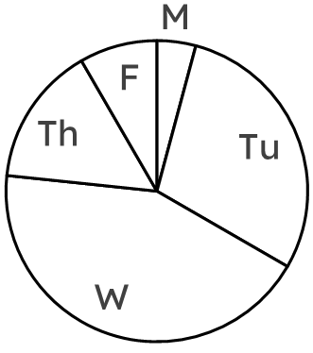
Interpreting pie charts
Task A: Calculating frequencies from the size of a sector
subject | frequency | angles
maths | 38 | 152°
English | 15 | 60°
science | 25 | 100°
other | 12 | 48°
total | 90 | 360°
1) A group of students were asked what their favourite subject was. 25 students voted for “science”.
a) Calculate the multiplier for this set of data.
b) Calculate all other frequencies by dividing using this multiplier.
c) Calculate the total number of students who were asked.
× .
4
2) Oakfield Academy are organising a fair to raise money to improve environmental efficiency of their school.
The data shows votes of students for what they will do during the fair.
Calculate all missing frequencies.
activity | frequency | angles
cake sale | 21 | 63°
concert | 39 | 117°
charity race | 50 | 150°
face painting | 10 | 30°
total | 120 | 360°
× .
day | freq. | angles
Monday | 5 | 15°
Tuesday | 35 | 105°
Wednesday | 52 | 156°
Thursday | 18 | 54°
Friday | 10 | 30°
3
3) The pie chart shows the suggested days of the week the fair could be run on.
Complete the table by:
a) measuring all missing angles,
b) calculating all missing frequencies.

Slide 2
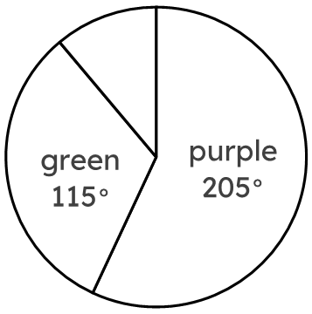
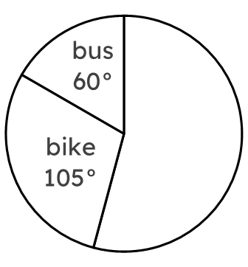
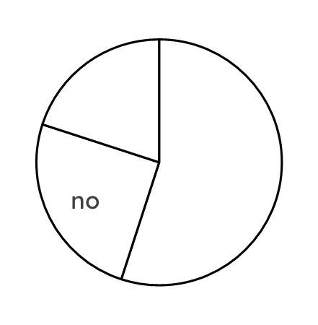
Interpreting pie charts
4) Fill in all missing information for each table.
colour | freq. | angles
purple | 41 | 205°
green | 23 | 115°
blue | 8 | 40°
total | 72 | 360°
vehicle | freq. | angles
car | 13 | 195°
bike | 7 | 105°
bus | 4 | 60°
total | 24 | 360°
vote | freq. | angles
yes | 165 | 198°
no | 75 | 90°
undecided | 60 | 72°
total | 300 | 360°

Slide 3
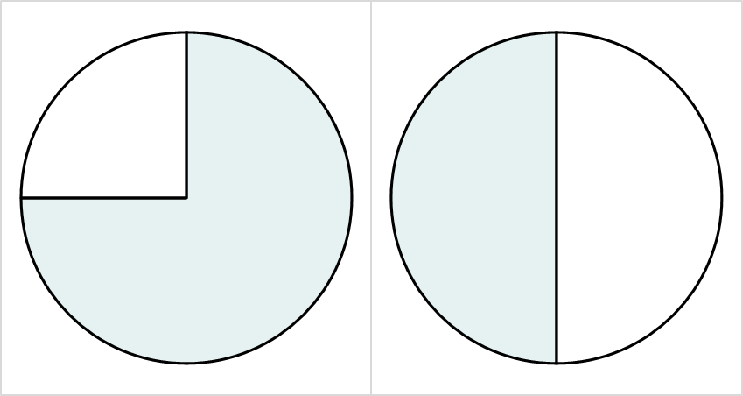
Interpreting pie charts
Task B: Comparing pie charts
1) A headteacher is comparing the exam results of two classes.
Class R
Class P
The headteacher says “more students passed the exam in Class R”.
The headteacher may be incorrect. Can you explain why?
fail
pass
fail
pass
A higher proportion of students in Class R (three-quarters) passed the exam than Class P (half).
However, Class R could be a lot smaller than class P so that the three-quarters of a small class is smaller than half of the bigger Class P.
Class size of 12
Class size of 30
Three-quarters of 12 is 8.
Half of 30 is 15.
Class R
Class P
2) In both classes, 15 students passed the exam.
Complete the ratio tables below to work out which class had more students.
fail
pass
fail
pass
Class P had 10 more students.
Class R
Class P
pass | fail | total
270 | 90 | 360°
15 | 5 | 20
pass | fail | total
180° | 180° | 360°
15 | 15 | 30
v2.2

Slide 4
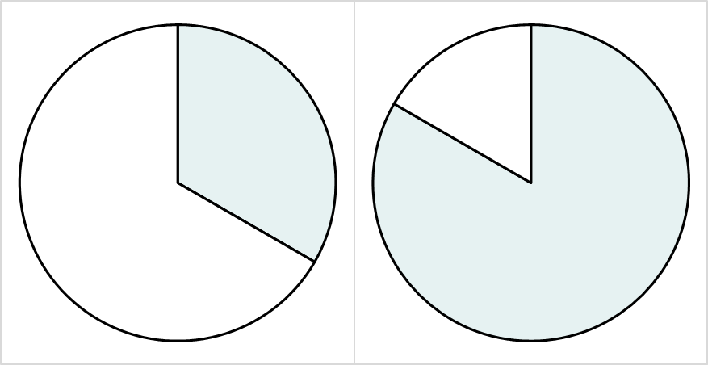

Interpreting pie charts
3) People in Leeds city centre were asked whether they support Leeds United, and whether they would watch Leeds United’s next football match.
Two pie charts were drawn, one to show supporters, and one to show non-supporters.
a
b
won’t
watch
watch
won’t
watch
watch
Which of the two pie charts represents the group of people who support Leeds United? Explain how you know.
Pie chart b is more likely to represent people who support Leeds United, as they are more likely to watch their matches than someone who doesn’t support the team.
4) The minor sector of each group both represent 80 people.
In which group were more people interviewed, and by how many people?
Fill in the ratio tables to help.
a
b
won’t
watch
60°
watch
120°
won’t
watch
240°
watch
300°
group a
group b
watch | won’t watch | total
120° | 240° | 360°
80 | 160 | 240
watch | won’t watch | total
300° | 60° | 360°
400 | 80 | 480
480 - 240 = 240 more people were interviewed in group b.
Mathematics in Education and Industry
v2.2

